Slide 1
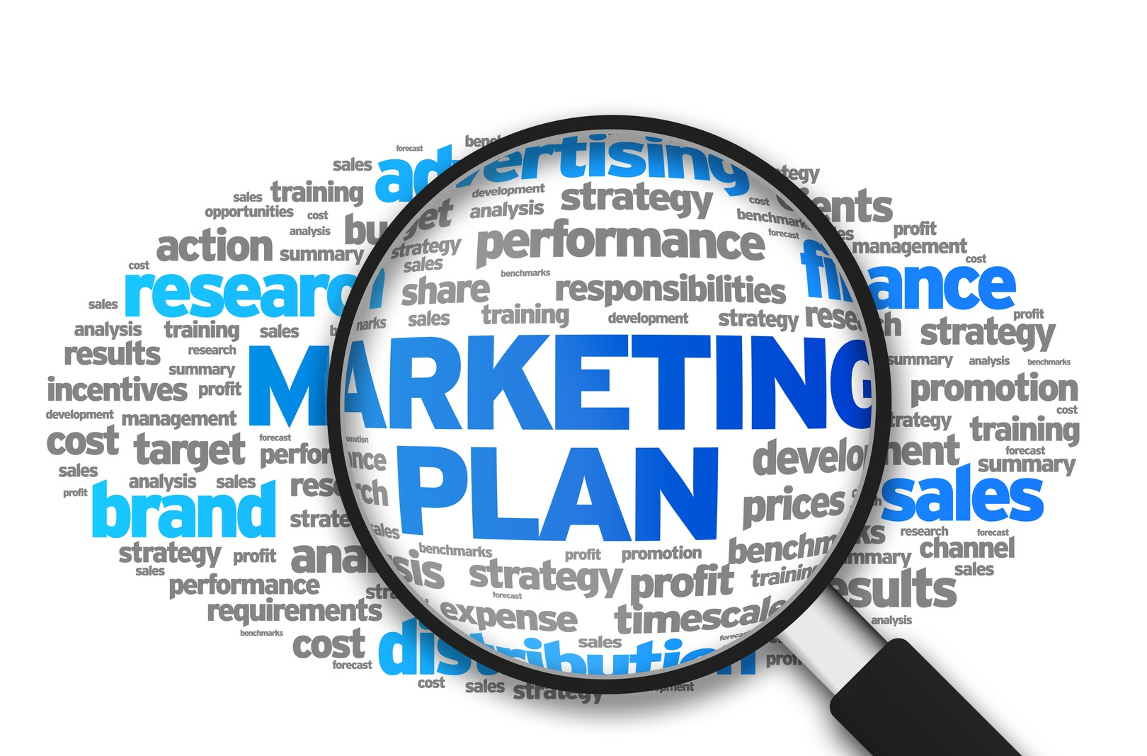
Marketing Planning and Strategy

Slide 2
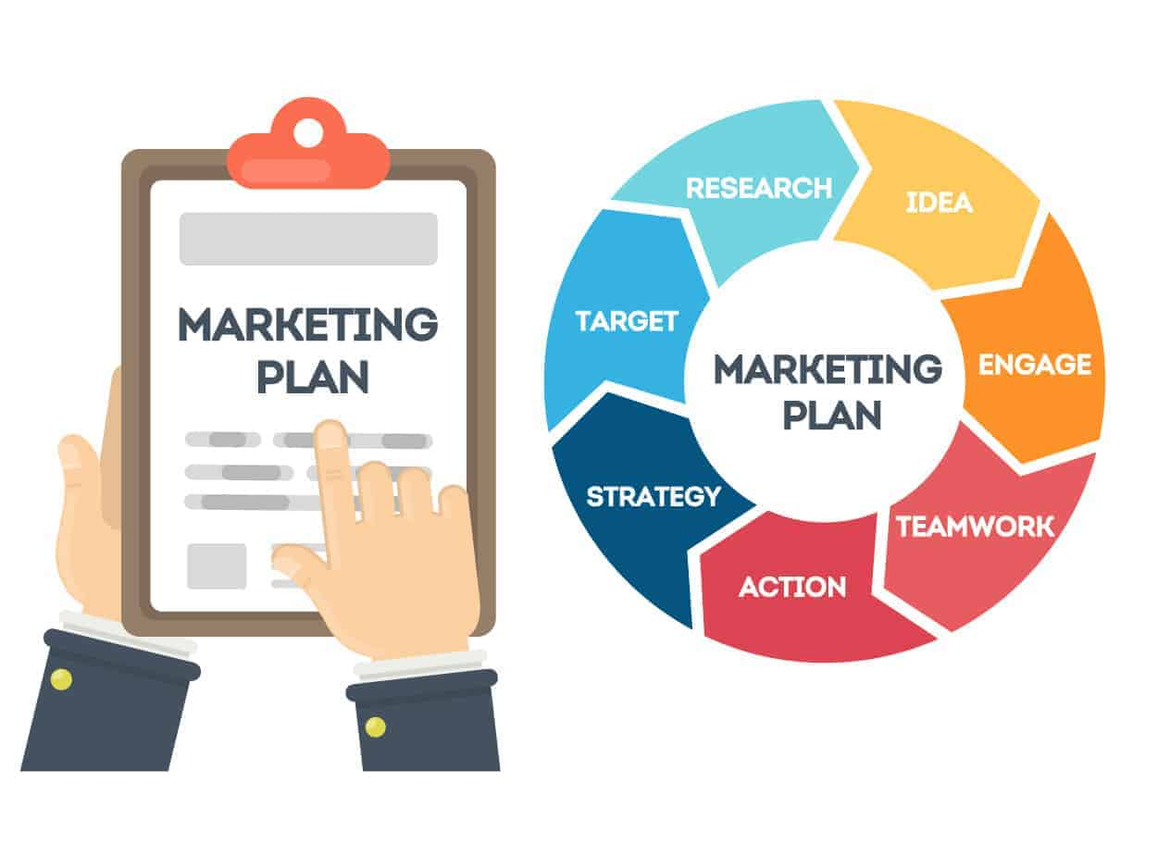
Need for corporate planning
Larger business and more complex structures
Technological advancement means greater capital investment - long-term planning needed to obtain finance
Increasing pressure for greater profitability
Better planning tools available through IT
Evolution of plan with management team ensures co-operation and co-ordination of effort between departments and SBUs
Imposes discipline to think beyond short term
(A. Smith, 2020)

Slide 3
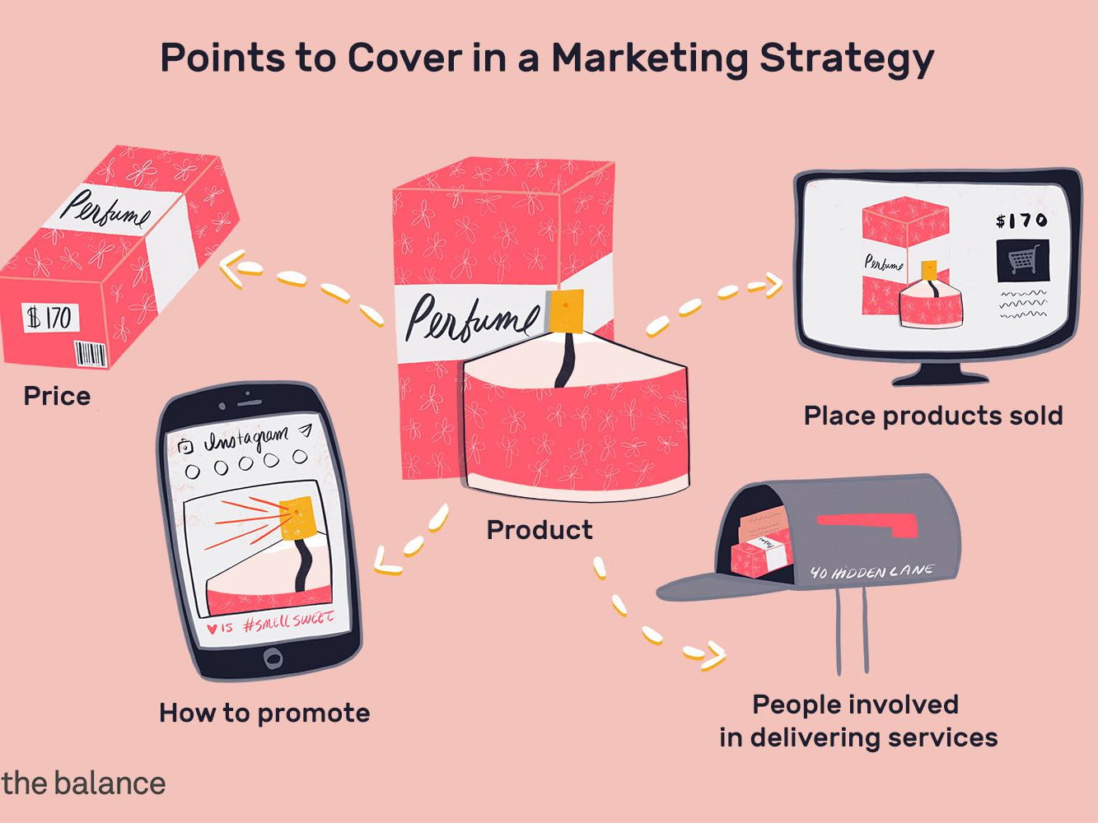
Marketing Strategy Concepts
Marketing Strategy
Determination of long-range goals and objectives; commitments of courses of action and allocation of resources necessary to achieve these goals
Strategic Marketing Planning
Long range, comprehensive framework that fits into the corporate plan
Tactics
Specific actions intended to implement strategy
(Aaker & Mills,2011)

Slide 4
MOST ANALYSIS
MISSION
What business are we in?
OBJECTIVES
What do we want to accomplish?
STRATEGIES
In general terms, how are we going to get the job done
Tactics
Specific actions intended to implement strategy
(Casadesus-Masanell, R., & Ricart, J. E., 2010)

Slide 5
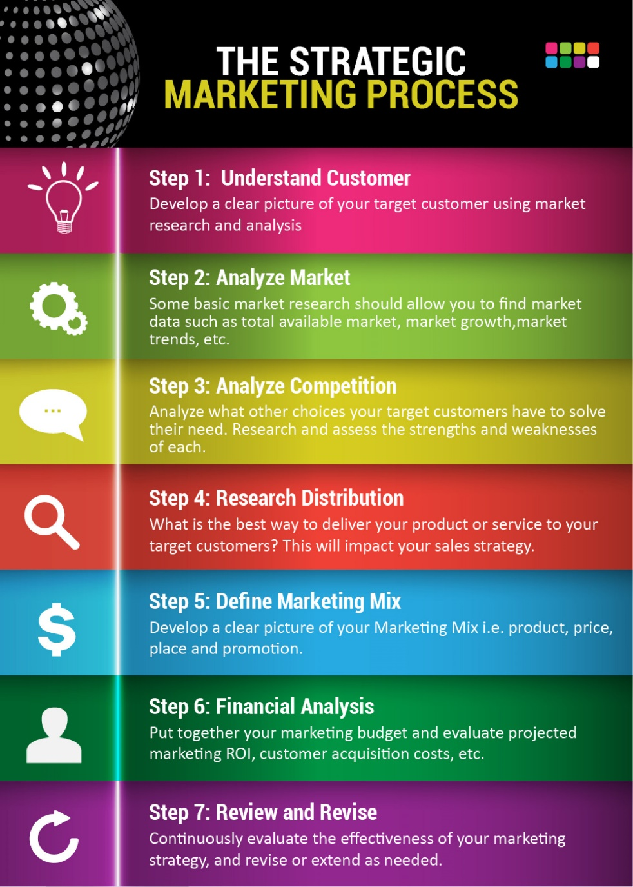
Stages of the Strategic Marketing Process
Planning stages
Identify and evaluate opportunities
Analyse market segments and select target markets
Plan a market position and develop a marketing mix
Prepare a formal marketing plan
Execute the plan
Control efforts and evaluate the results
Execution stage
Control stage
(Kotler, 2018)

Slide 6
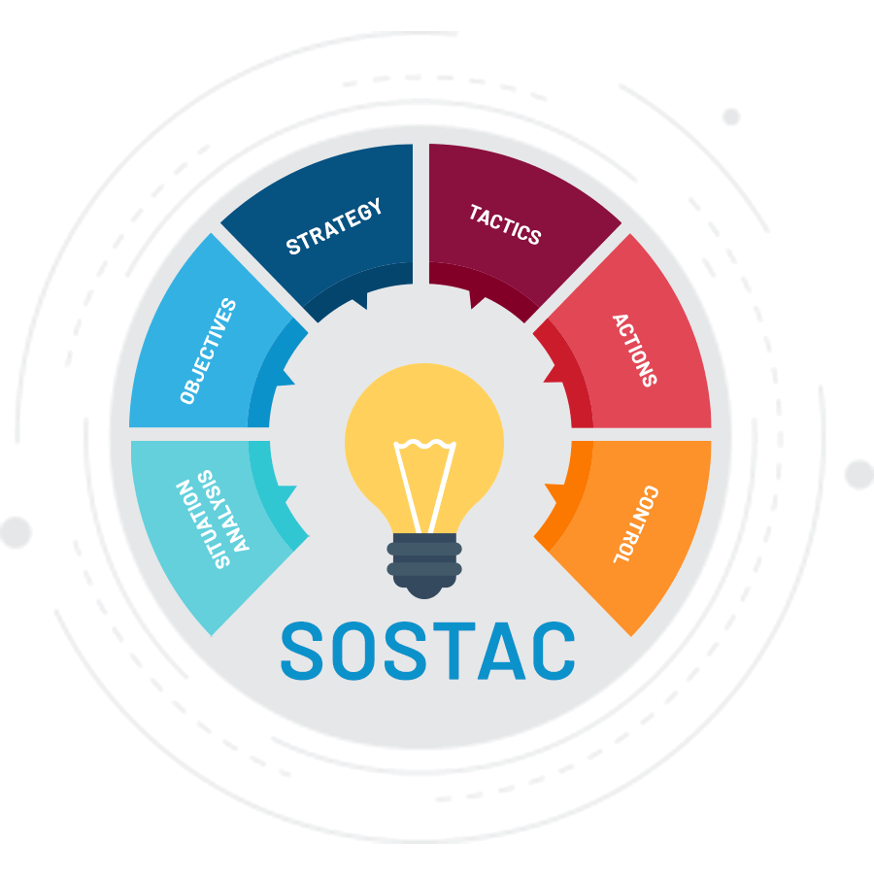
SOSTAC framework for marketing planning
Situation analysis (where are we now?) - current position from SWOT
Objectives – (where do we want to go?) quantified and SMART
Strategy – (how do we get there?) segmentation, targeting and positioning
Tactics – (the details of strategy) how marketing mix will be developed to establish agreed positioning
Actions –(implementation – putting the plans to work) timetable to ensure co-ordination
Control – (measurement, reviewing and modifying) information needs and budget to monitor progress
(P.R. Smith, 2020)

Slide 7
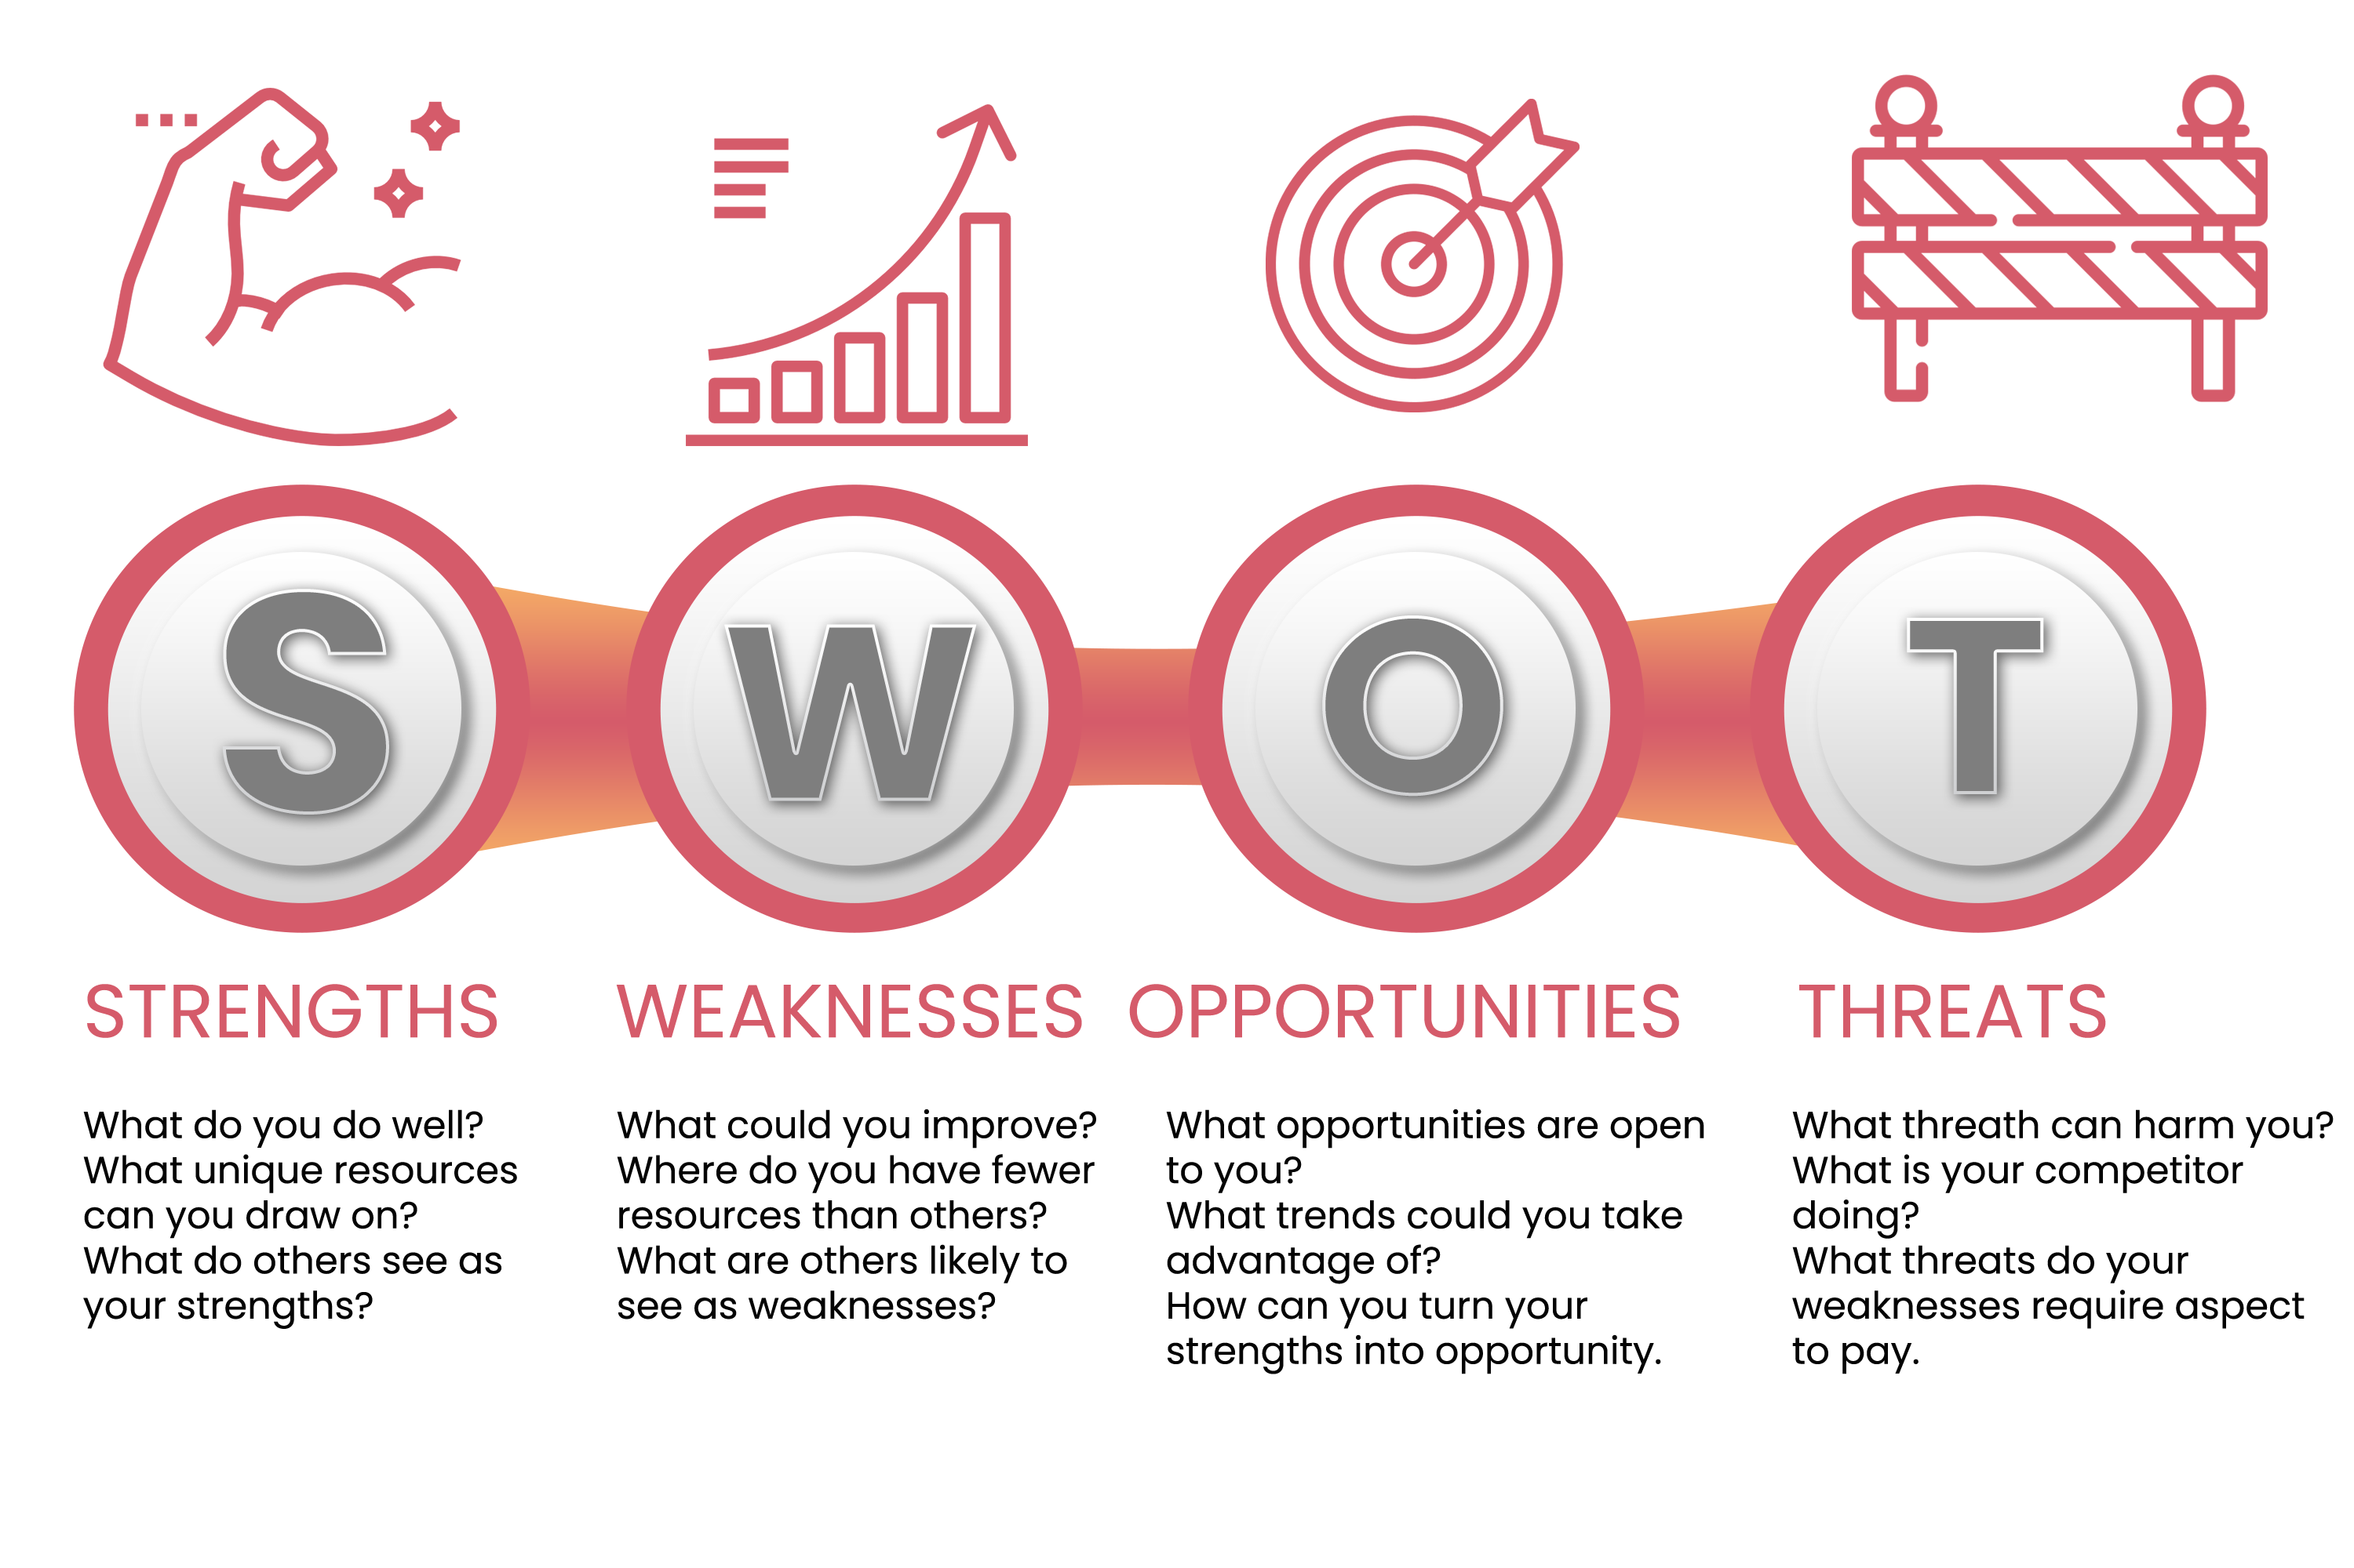

Slide 8
Strategic marketing planning process
1 Mission
2 Corporate objectives
3 Marketing audit
Goal setting
4 SWOT analysis
5 Assumptions
6 Marketing objectives and strategies
7 Estimate/forecast results
Situation review
8 Identify alternative plans and mixes
9 Budget
10 1st yr detailed programme
Strategy formulation
11 Measurement and review
(J. Weller, 2017)
Resource allocation monitoring

Slide 9
Goals and mission statements
Ideological goals – beliefs and values – sometimes termed ‘mission’
Formal goals – set for the organisation as policy, usually formulated in the boardroom
GlaxoSmithKline ‘…an integrated research based group whose corporate purpose is to create, discover, develop, manufacture and market throughout the world, safe, effective medicines of the highest quality which will bring benefit to patients…..’
IBM ‘Market-driven quality is our aim. It means listening and responding more sensitively to our customers, eliminating defects and errors, speeding up our processes, measuring everything we do against a common standard, and involving employees totally in our aims’
Apple Computers ‘Our goal is to create the world’s friendliest, most understandable, most useable computers that empower the individual’

Slide 10
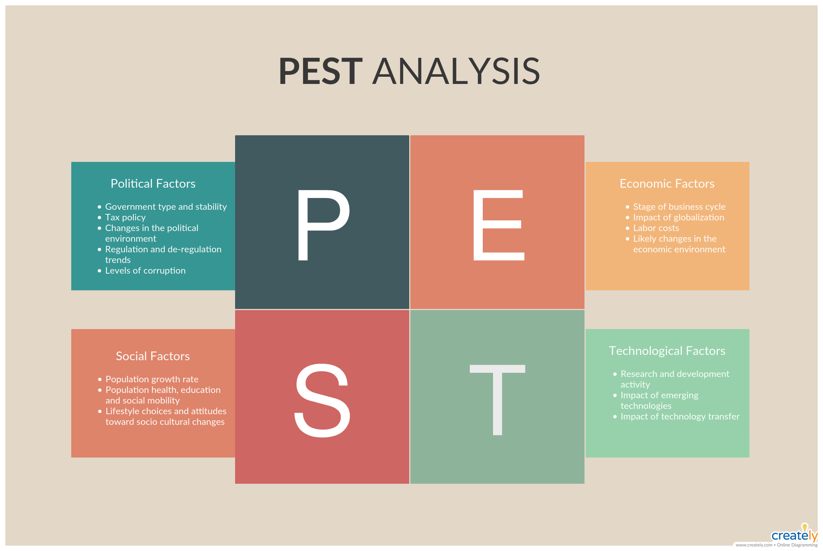

Slide 11


Slide 12
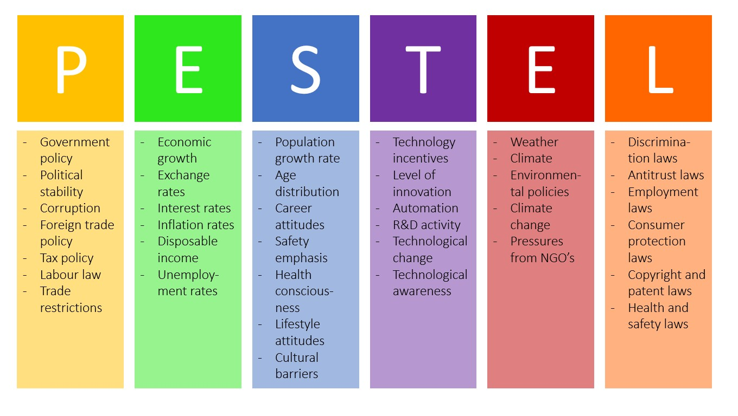

Slide 13
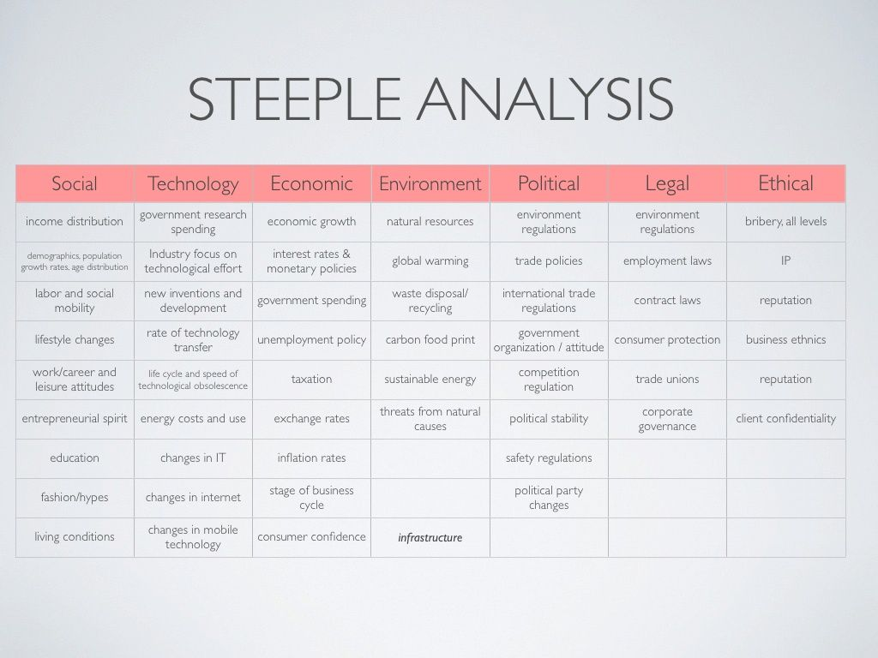

Slide 14
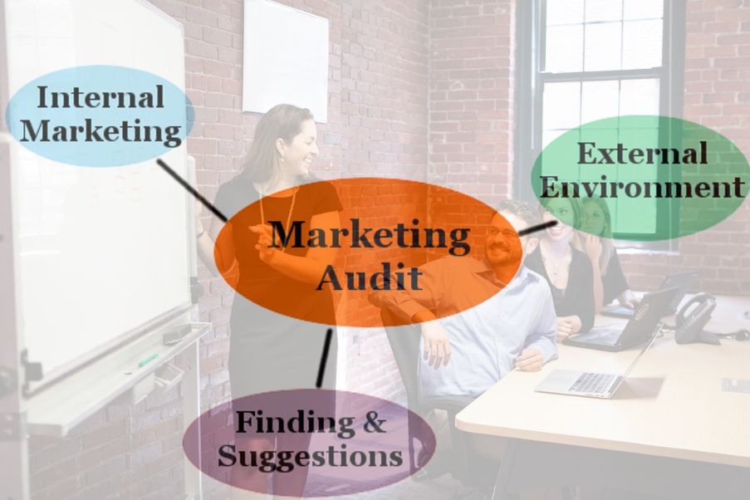
Marketing audit technique
Detailed questionnaire explores important aspects
Careful and comprehensive audit so each topic is thoroughly examined
Preliminary findings prepared for each step
Diversity of viewpoints is sought to arrive at full understanding
Begin with top management and work down to specialist marketing functions
Final written report covers entire scope of investigation
(Madison Majeed, 2019)

Slide 15
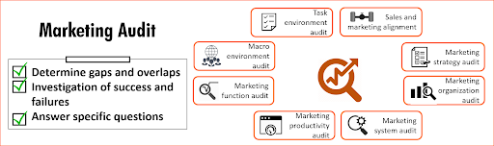
The marketing (product) audit
Checklist covers each major product/product group:
Market share
Consumer likes/dislikes
Historical sales trend
Seasonality
Proportion of total company sales
Contribution margin (of profit)
Proportion of total contribution (to all sales)
Return on investment
How it fits the company’s product mix
(B. Hendricks, 2020)

Slide 16
Why forecast?
Assists management to plan more scientifically
Time horizons
Short term - up to 3 months
Medium term - 1 year (ie the normal business cycle)
Long term - 2 5 10+ years

Slide 17
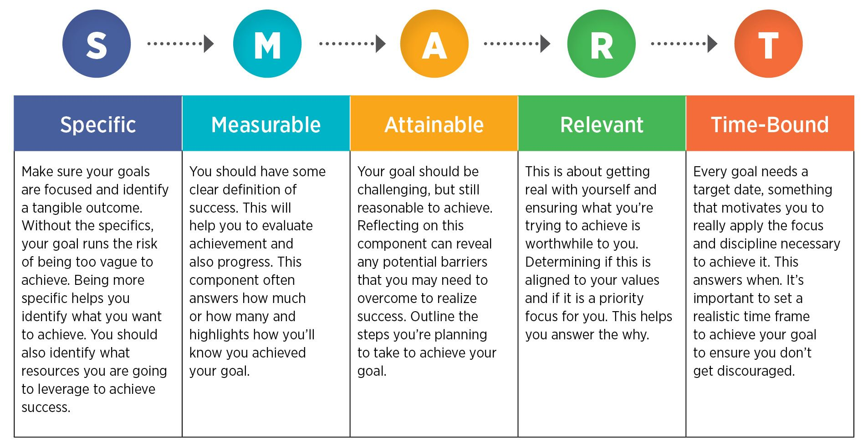
SMART marketing objectives
(R. Rubin, 2019)

Slide 18
Measurement and Review
Final stage is to establish standards against which progress can be checked as plans are carried out in practice. Therefore quantities and timescales should be put into marketing objectives
Criteria above will have been specified and plan will show what levels are expected to be achieved in a full year, each quarter and even weekly. This allows a progress check as the year unfolds and take action if needed, so there is a feedback loop to earlier parts of the programme to make adjustments in the light of what has happened.
Performance needs monitoring at greater levels of detail. e.g. Are you really giving customers deliver in 48 hrs? Is this level of service costing too much?
Measures of performance are a way of telling if you are on track and give opportunity to make adjustments to plans

Slide 19
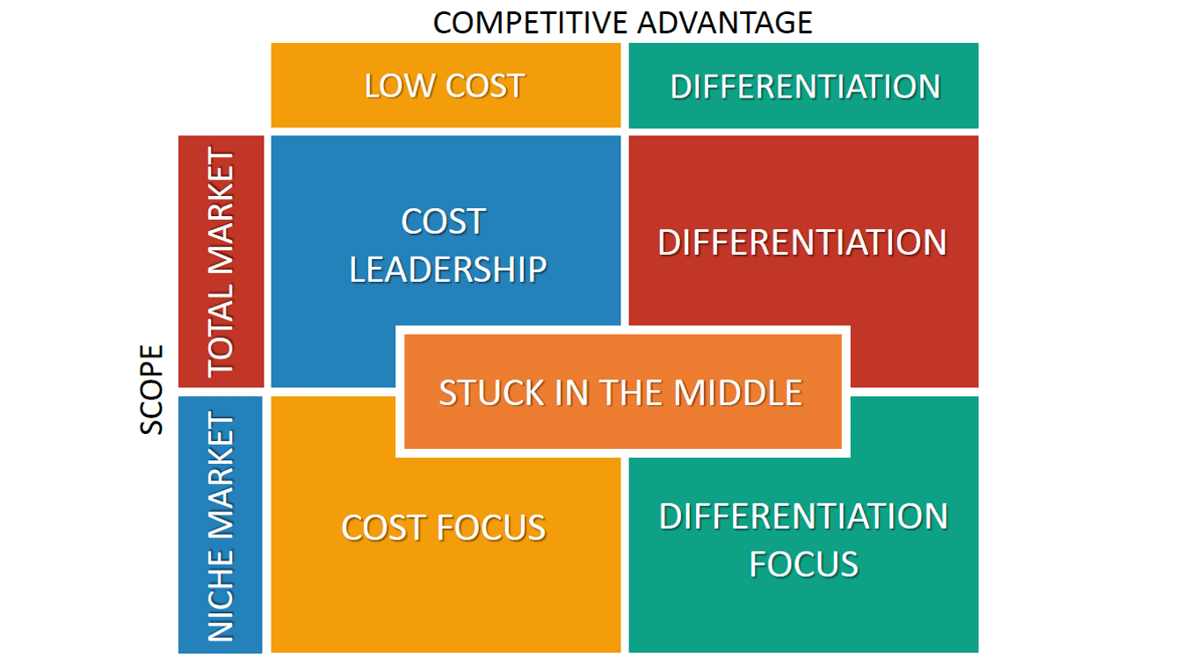
Porter’s Generic Strategies

Slide 20

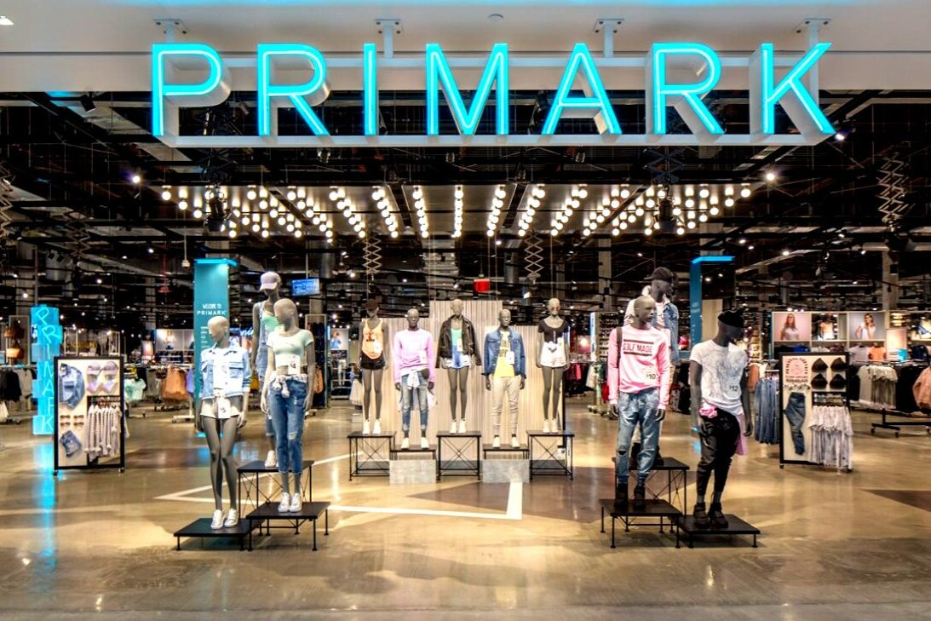

Porter’s Generic Strategies: Cost Leadership
This strategy involves aiming to be lowest cost producer in the industry. The organisation aims to drive costs down from production to sourcing to labour costs. The cost leader usually aims at a broad market, so sufficient sales can cover costs. Low cost producers include Easyjet, Ryan Air and Asda. Some organisations may aim to drive costs down, but not pass these savings to customers, aiming for increased profits because their brand commands a premium rate.

Slide 21

Porter’s Generic Strategies: Differentiation
Organisations strive to be different. Having competitive advantage that allows company and its products stand out is crucial for success. With a differentiation strategy the organisation can focus efforts on particular segments and charge for added differentiated value. Brompton folding cycles’ compact design differentiates them from other folding bike companies. New concepts that allow for differentiation can be patented, but these have limited life span and face danger that an idea that gives a competitive advantage will be copied in one form or another

Slide 22

Porter’s Generic Strategies: Niche strategy (focus)
The organisation focuses effort on a particular segment and becomes well known for providing products/services within the segment. They form a competitive advantage for this niche market and succeed by being a low cost producer or differentiator within the segment. e.g. Rolls Royce and Bentley

Slide 23

Are you ‘Stuck in the middle’?
Danger some organisations face is they try to do all three of Porter’s strategies and become ‘stuck in the middle’. They have no clear business strategy, be all things to all consumers, which adds to running costs causing a fall in sales and market share. ‘Stuck in the middle’ companies are often subject to takeover or merger

Slide 24
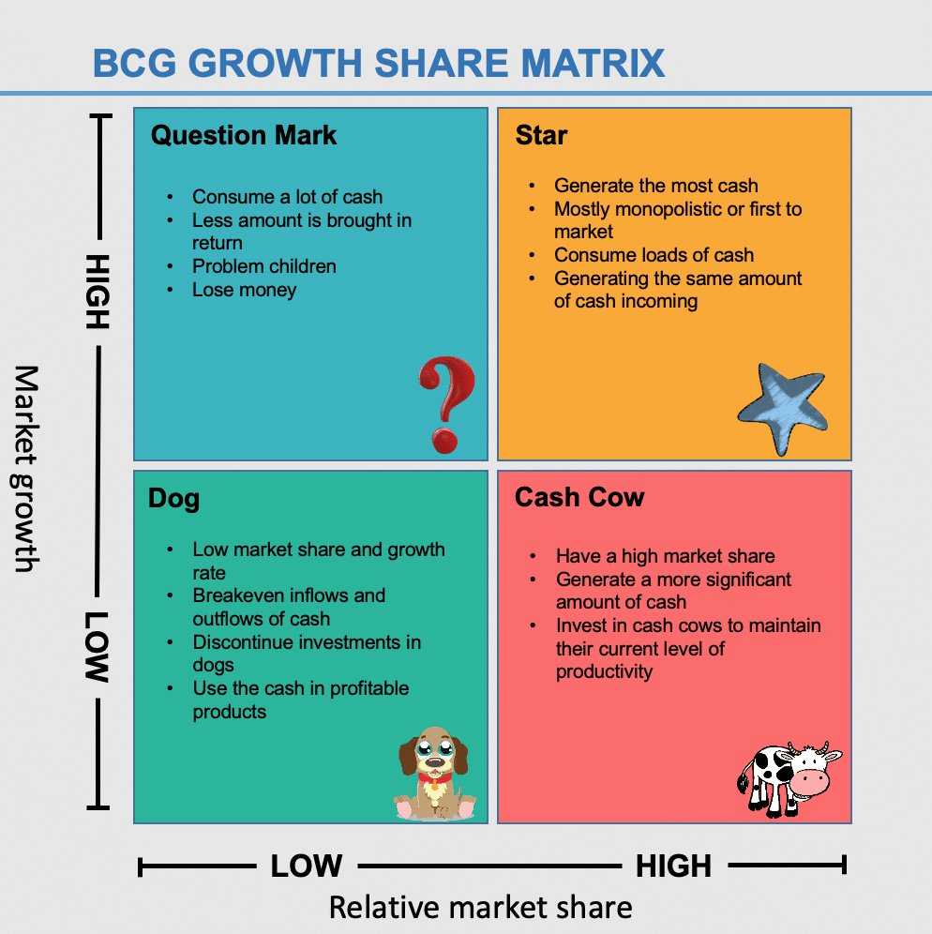
The Boston Consulting group’s product portfolio matrix (BCG matrix) is designed to help with long-term strategic planning, to help a business consider growth opportunities by reviewing its portfolio of products to decide where to invest, to discontinue or develop products. It's also known as the Growth/Share Matrix.
To apply the BCG Matrix you can think of it as showing a portfolio of products or services, so it tends to be more relevant to larger businesses with multiple services and markets. However, marketers in smaller businesses can use similar portfolio thinking to their products or services to boost leads and sales.

Slide 25
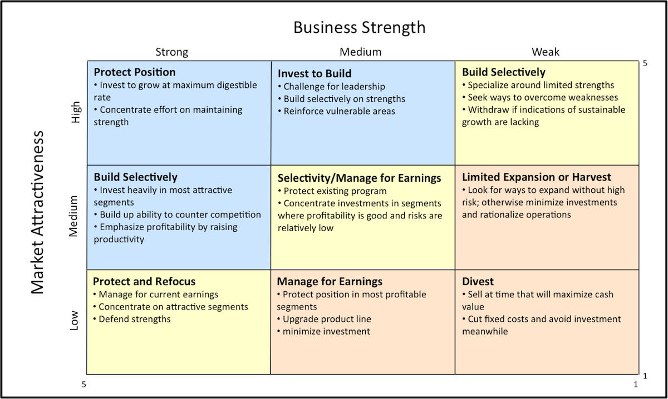
General Electric Matrix

